Slide 1
Pulp Fiction and Film Noir
The Hardboiled Fiction of Raymond Chandler and James M. Cain

Slide 2
“Hardboiled” (Pulp) Fiction
In the 1920s and 1930s, cheap newsprint led to an increase in pulp magazines like The Black Mask.
The “pulps” published detective stories with sensational plots featuring crime, sex, money, blackmail, etc.
Raymond Chandler, James M. Cain, and Dashiell Hammett published fiction in these magazines.
Notes:
Essays in definition:
Edmund Wilson, “The Boys in the Back Room”
Raymond Chandler, “The Simple Art of Murder”

Slide 3
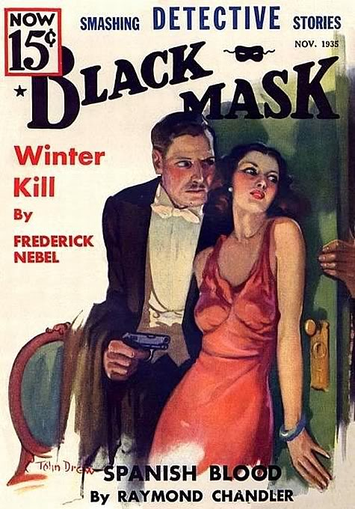
Hardboiled Fiction, continued
Early reflection of alienation and the dark underside of the American dream.
Influenced the films that would later be called film noir.
Urban settings, including Los Angeles.

Slide 4
Why Los Angeles?
As we discussed yesterday, there’s an ironic resonance in its name: “city of angels.”
An environment full of nondescript modern buildings.
City of transitory residents: alienation, lack of sense of community.
City of illusions: Hollywood’s “dream factory.”
A city of automobiles, with no true central core in the sense of other cities.
Ironic contrast between the bright, sunny climate and the dark corruption of the people.
Gertrude Stein: “There is no there there.”

Slide 5
Characteristics of Hardboiled Fiction
Alienated characters confront a world of chaos and corruption in which (they believe) two wrongs can make a right. There’s a sense that crime might just pay—this time.
“Hardboiled”: absence of sentimentality or overt moralizing.
Stoic or disaffected attitudes complicated by (negative) emotions such as sexual passion, anger, greed, or a desire for revenge.

Slide 6
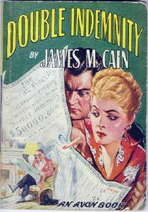
Characteristics, continued
Often a “get rich quick” approach to the American dream. Success depends not on hard work but on the “big score”—beating the system by defrauding its institutions.
In Double Indemnity, the insurance industry is the institution.

Slide 7
The Detective Character
Tries to make sense of the confusion he sees around him and order out of the chaos.
Lives by a code of his own but may break the law in doing what he believes is right.
Refuses to accept the authority of corrupt institutions (police, wealthy industrialists) and, through his use of wit, is often openly defiant toward and dismissive of them.

Slide 8
The Detective Character, continued
Sometimes a chivalrous figure (a “knight”) protective of women and weaker characters.
Disillusioned by human nature, since people routinely lie to him, but continues to try to fight injustice.
Dashiell Hammett: Sam Spade, The Maltese Falcon
Raymond Chandler: Philip Marlowe
James M. Cain: doesn’t use the detective figure as a protagonist in Double Indemnity

Slide 9
From “The Simple Art of Murder”
“But down these mean streets a man must go who is not himself mean, who is neither tarnished nor afraid. The detective in this kind of story must be such a man.”
“He talks as the man of his age talks, that is, with rude wit, a lively sense of the grotesque, a disgust for sham, and a contempt for pettiness.”
“The story is his adventure in search of a hidden truth, and it would be no adventure if it did not happen to a man fit for adventure.”

Slide 10
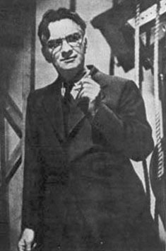
James M. Cain, 1892-1977
Background: WWI veteran, journalist, editor, screenwriter.
Was the first to use the plot of a wife murdering a husband for the insurance.
The Postman Always Rings Twice (1934)
Double Indemnity (1936)
Mildred Pierce (1941)

Slide 11
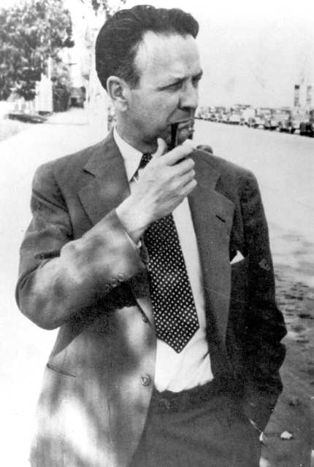
Raymond Chandler, 1888-1959
Background: British, ed. Dulwich College, London; WWI veteran; accountant.
Fascinated by American slang and use of language,.
The Big Sleep (1939)
Farewell, My Lovely (1940)
The Lady in the Lake (1943)
Screenplay (with Billy Wilder) for Double Indemnity (1944)
The Long Goodbye (1953)

Slide 12
Double Indemnity
Screenwriters: Raymond Chandler and Billy Wilder; directed by Billy Wilder
Chandler, interested in language, added wit and depth to the book’s dialogue, which even Cain admitted “wouldn’t play.”
Wilder, who had been a director in Germany, brought an outsider’s view to the depiction of Los Angeles and Cain’s “American” story.

